Slide 1
THE LIBRARY BOOK CIRCULATION SYSTEM

Slide 2
INTRODUCTION:
The Library Management System is an application for assisting a librarian in managing a book library in a university. The system would provide basic set of features to add/update members, add/update books, and manage check in specifications for the systems based on the client’s statement of need.
Management software for monitoring and controlling the transactions in a library .The project “Library Management System” is developed in php, which mainly focuses on basic operations in a library like adding new books, and updating new information, searching books and members and return books.
.

Slide 3
ABSTRACT:
The project titled Library Management System is Library management software for monitoring and controlling the transaction in a library. The project “Library Management System” is developed in java, which mainly focuses on basic operations in a library like adding new member, new books, and updating new information, searching books and members and facility to borrow and return book.

Slide 4
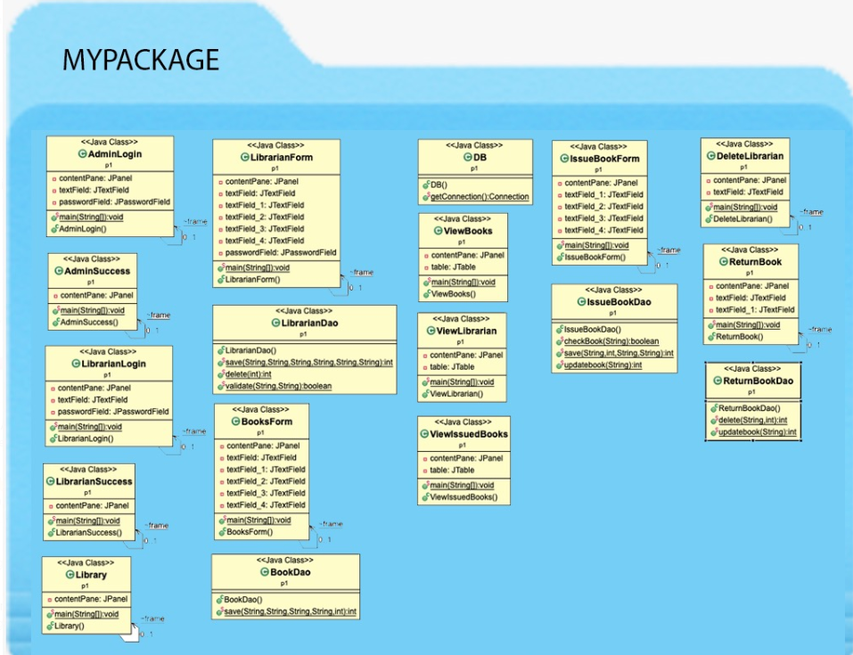
CLASS DIAGRAM :

Slide 5
WE IMPLEMENT THE CODE BY THE FOLLOWING STEPS :
For your better understanding, We have divided the code into the following functions :
Login
Connect
Create/ Reset
User Menu
Admin Menu

Slide 6
LOGIN:
We have created this function to enable the user and the admin login. So, initially when a user logs in for the first time, that user will be an admin by default, and the username and password will be {admin, admin}
For this schema, I have considered only one admin. So, once a user logs in as an admin, he or she will be redirected to the admin menu as below. I will discuss the functions of the admin in the admin menu section.

Slide 7
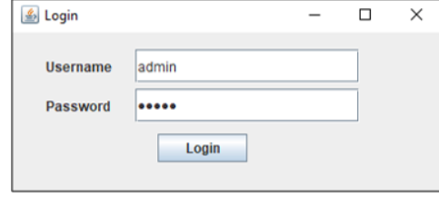
LOGIN FORM:

Slide 8
CONNECT:
The connect function is used to connect the database to the GUI.
In the above function, we are connecting our MySQL database with the username “root” and password “edureka” to our application. Now, once the application is connected to the database, our next step is to create or reset the database. So, next in this article on Library Management System Project in Java, let us discuss the Create function.

Slide 9
CREATE:
The create function is used to create the database, tables and add data into these tables. Now, that we have created the database, connected with GUI and enables the login function, next in this article on Library Management System Project in Java, let us now discuss the functions of the User Menu.

Slide 10
USER MENU:
The User Menu is designed to show details of all the books present in the library and the books issued by the user.
Next, in this article on Library Management System Project in Java, let us discuss the code for Admin Menu function.

Slide 11
ADMIN MENU:
The Admin Menu is designed to show details of users, books, issued books, add books, return books, add user, and create or reset the database.
Now that you have understood all the functions, let us execute our library management system project in Java and see the outputs.

Slide 12
CONCLUSION:
The library providers research facilities to the researchers
It is a fact that library is situated in far flung villager area but the owners of the library provide residential facilities to the researchers
They keep them as their honourable guests
They full entertain them wholeheartedly
Researchers do their research work in full peace and calm
Library is promoting research culture in the country

Slide 13
THE END

